Slide 1
Keyword and Data type
Presented by Jamil Rayhan
ID: 18CSE061

Slide 2
Keyword Definition
Keywords are predefined, reserved words used in Java programming that have special meanings to the compiler.
Because of this, programmers cannot use keywords as names for variables, methods, classes, or as any other identifier.

Slide 3
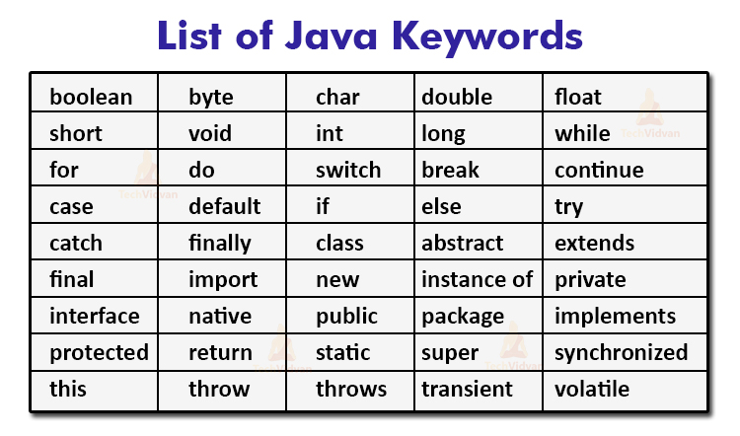
Keyword List
There are 52 keywords in java language (Source: wikipidia.org)

Slide 4
Data Types
Data type specifies the size and type of values that can be stored in an identifier.
The Java language is rich in its data types.
Different data types allow you to select the type appropriate to the needs of the application.

Slide 5
Data Types in Java
Data types in java are classified into
Primitive types
Non-primitive types

Slide 6
Primitive Types
Also known as Simple Data types.
Predefined by the language
Classified into two types
Numeric types
Non-numeric types

Slide 7
Non-primitive Types
Also known as Reference types
Non-primitive types are
Classes
Interfaces
Arrays

Slide 8
Data types in java
Primitive
Non-primitive
Numeric
Non-numeric
classes
Array
Integer
char
interface
Floating point
Boolean

Slide 9
Integer types
Java defines four integer types: byte, short, int, and long
byte is 8 bit width
short is 16 bit width
int is 32bit width
long is 64 bit width
Java doesn’t support unsigned types

Slide 10
Floating Point
Also known as Real number.
Used when fractional components are required.
Keywords used are ‘float’ and ‘double’.

Slide 11
Character type(char)
The data type used to store character is ‘char’.
Java used Unicode to represent characters.
Java character is 16 bit type. The range of the characters is 0 to 65,536

Slide 12
Boolean Type
It is use to represent logical values either true or false.
It uses only one bit of storage.
Keyword used is ‘boolean’.

Slide 13
Sources
www.google.com
www.wikipidia.com
www.slideshare.net
www.w3schools.com

Slide 14
Thank You

